Slide 1
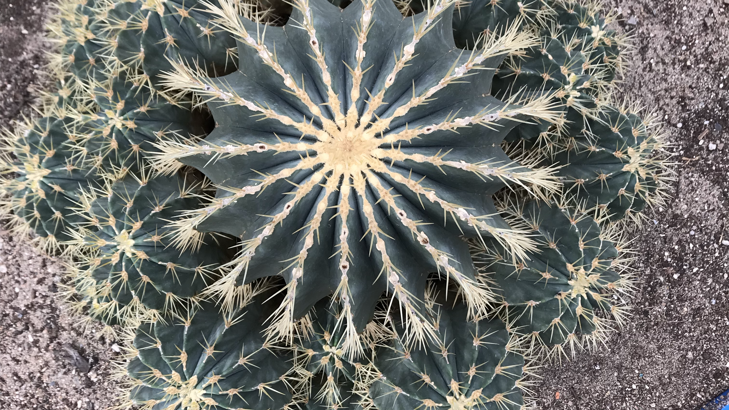
Use and knowledge of CACTACEAE in northeastern brazil
M. Laverick

Slide 2
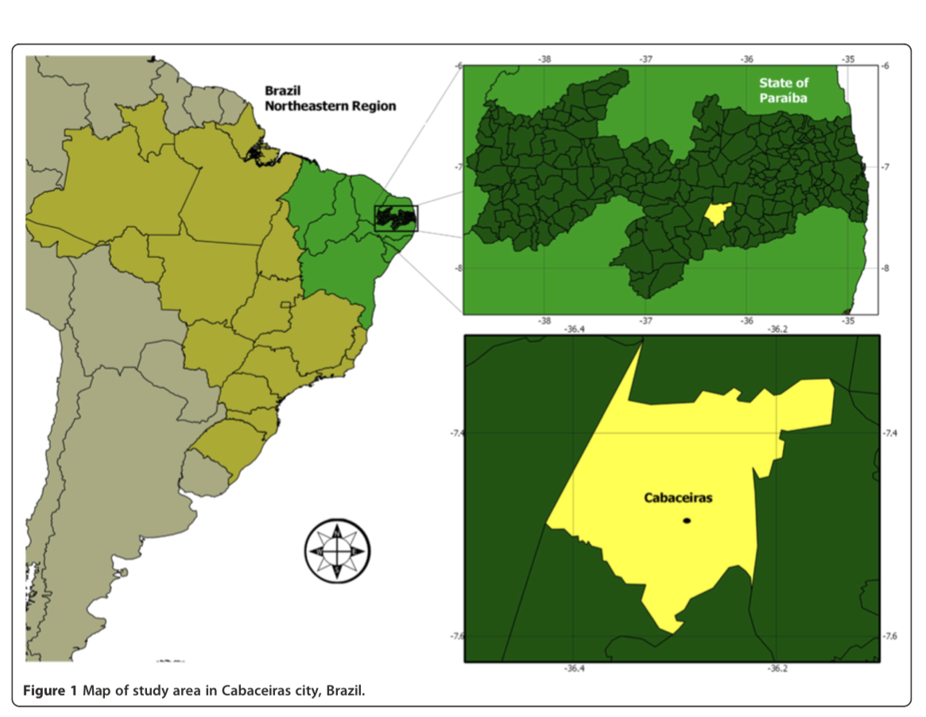
Study Methods
Study was done by Marques de Lucena et al. In the San Francisco community, Paraiba, Brazil exploring ethnobotanical uses of Cacrtace
118 local informants
9 main species

Slide 3
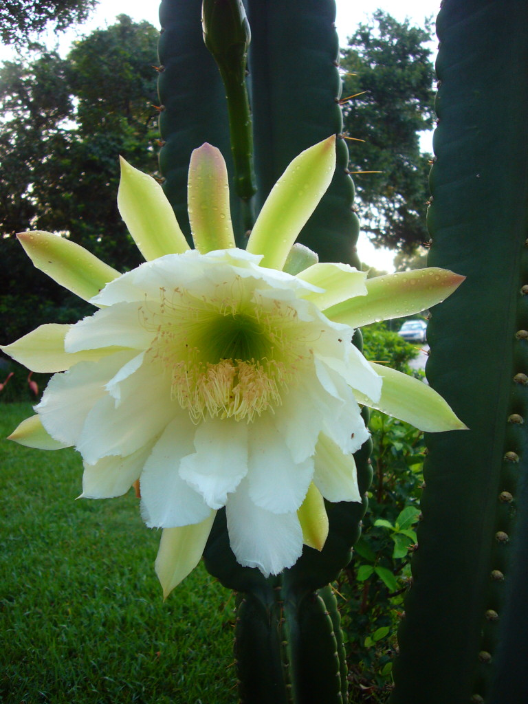
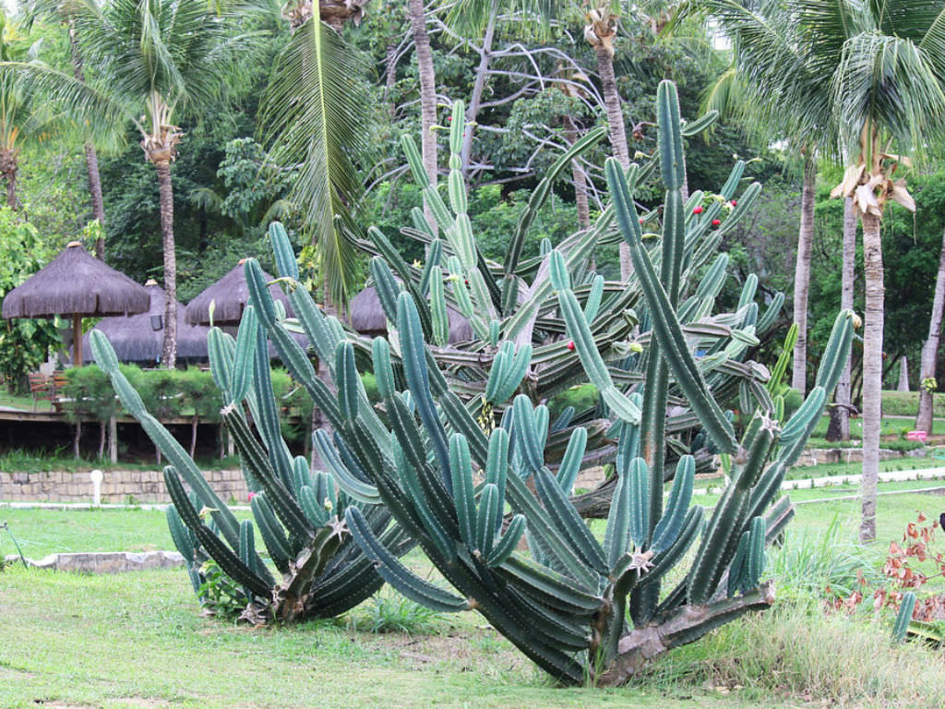
Cereus jamacaru
Uses:
  Fruit is used for candies or eaten fresh
  Wood used for construction (doors/housing)
  Tea from root medicinally used
  Syrups from marrow

Slide 4
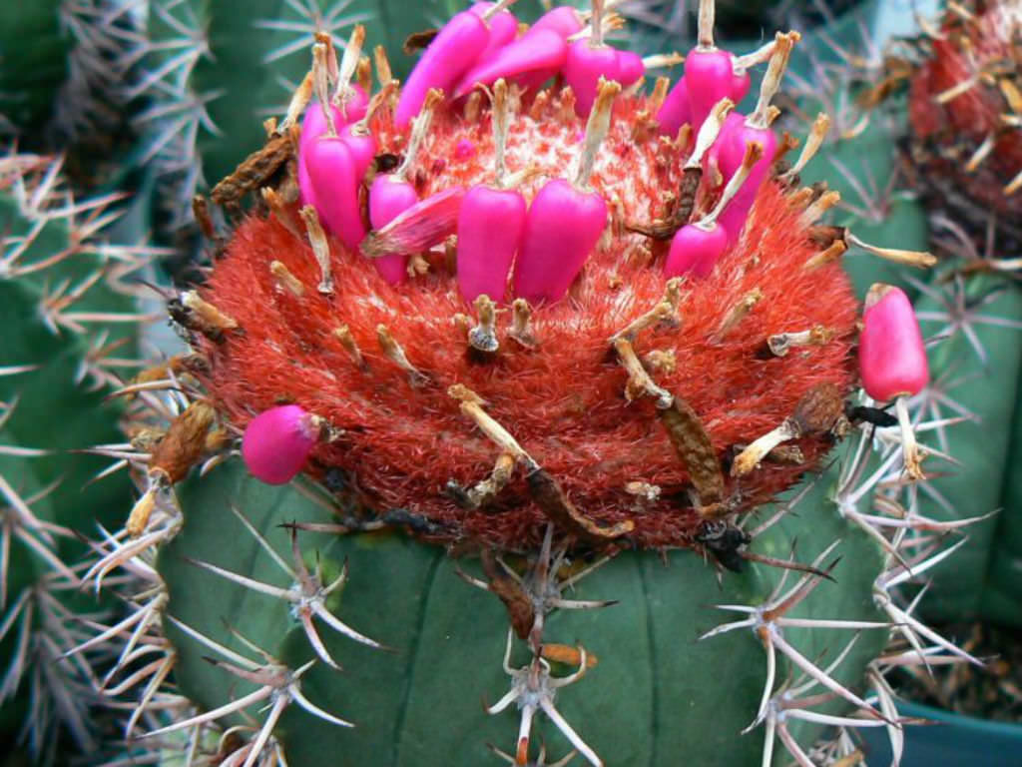
Melocactus bahiensis
Uses:
  Fresh fruit
  Fodder plant
  Ornamental
  Religious/magic uses
  Kernel is used in syrup

Slide 5
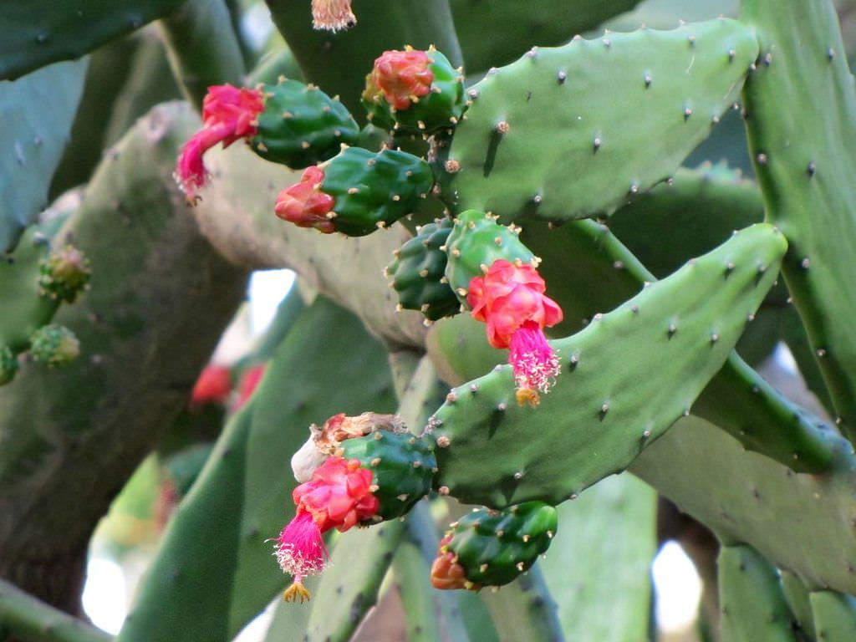
Nopales cochenilifera
Uses:
  Fruit
  Fodder
  Ornamental

Slide 6
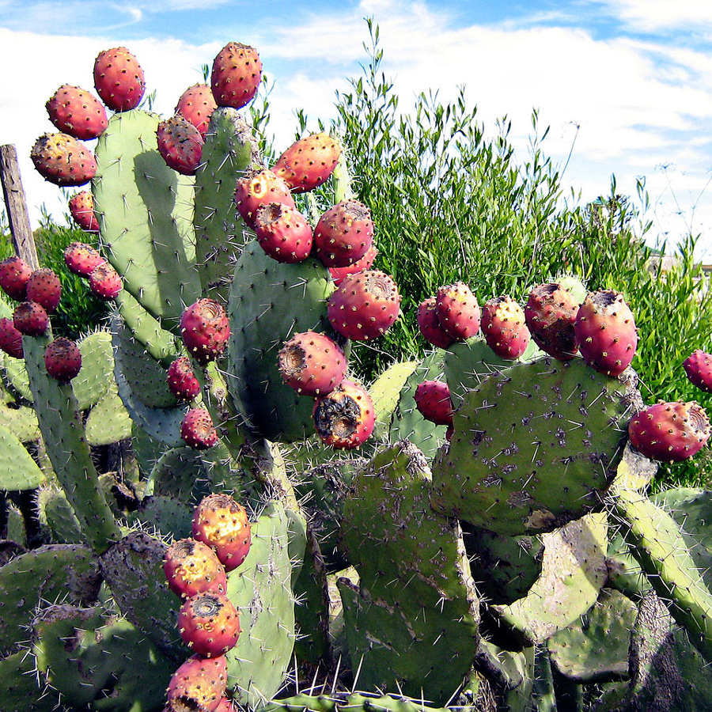
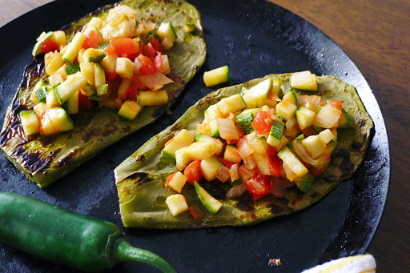
Opuntia ficus indica
Uses:
  Mostly a forage crop
  Used in many foods, fruit is commercialized as ‘figo da India”
  Hygine
  Religious magic
  Shade

Slide 7
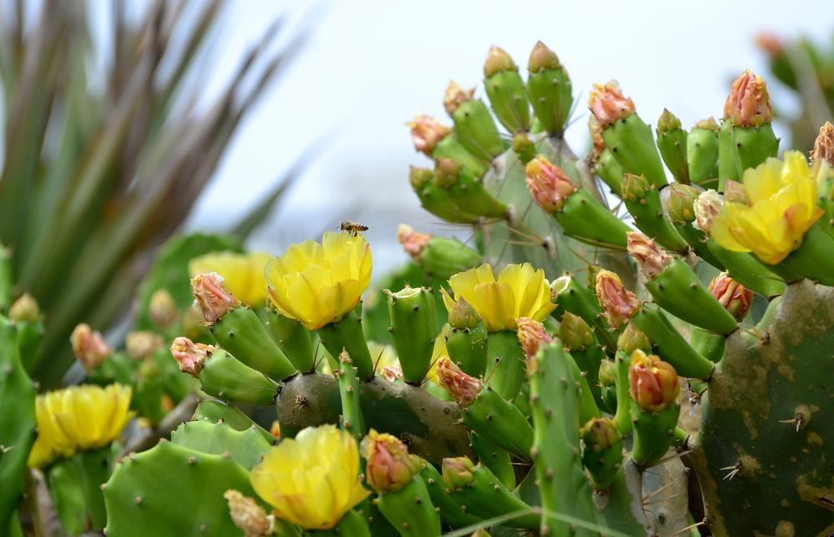
Opuntia stricta
Uses:
  Hedge fences
  Fruit
  Fodder
  Ornamental

Slide 8
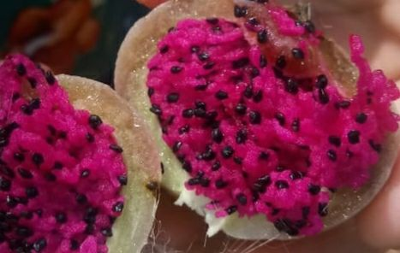
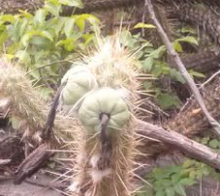
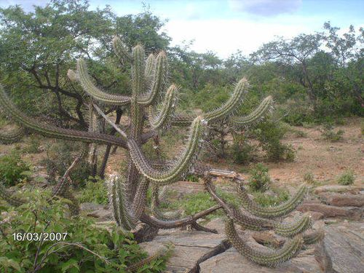
Pilosocereus gounellei
Uses:
  Marrow baked or cooked (candy or flour)
  Plant is burned and served to animals
  Ornamental
  Hygine

Slide 9
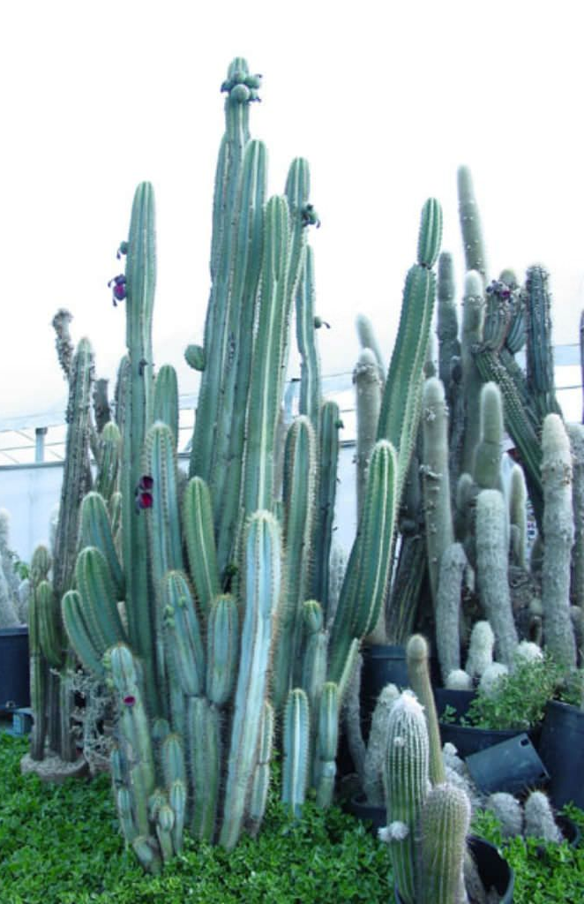
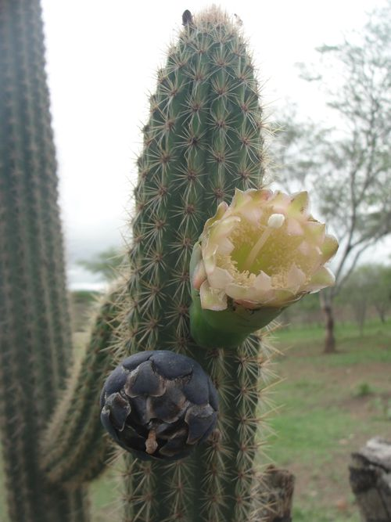
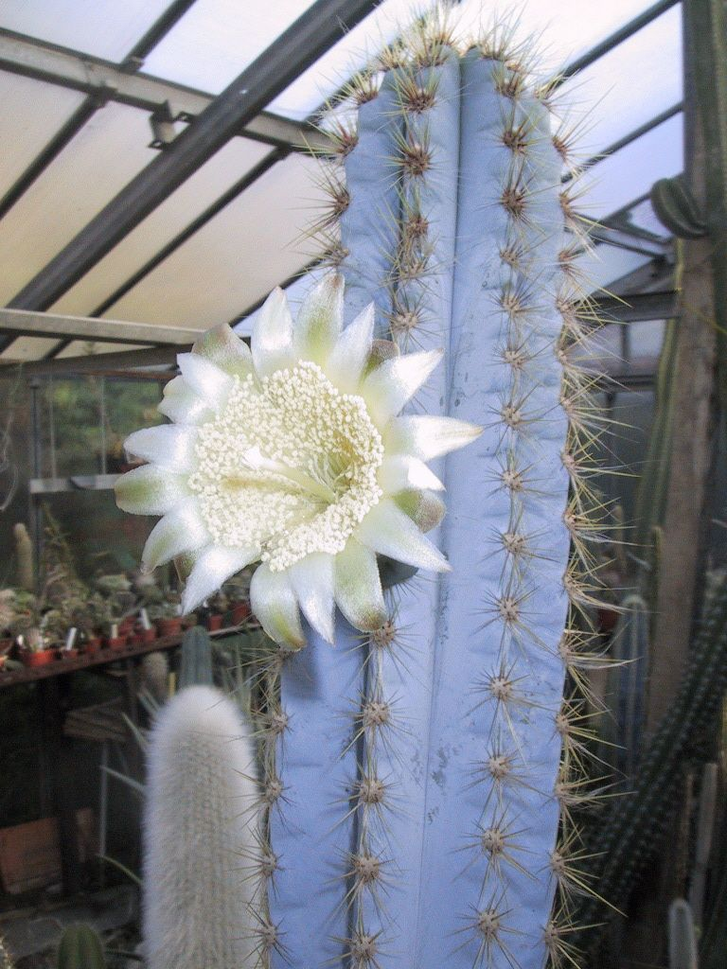
Pilosocereus pachycladus
Uses:
  Marrow is cooked or baked and eaten
  Fruit is eaten raw
  Wood used for firewood or as fences
  Shade
  Building tools

Slide 10
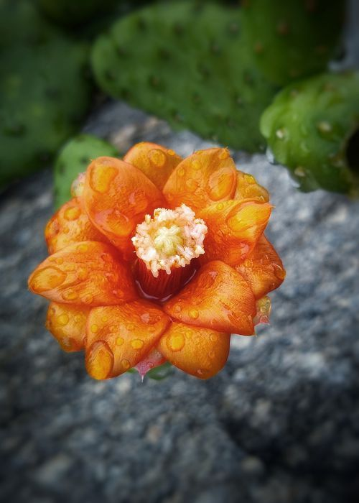
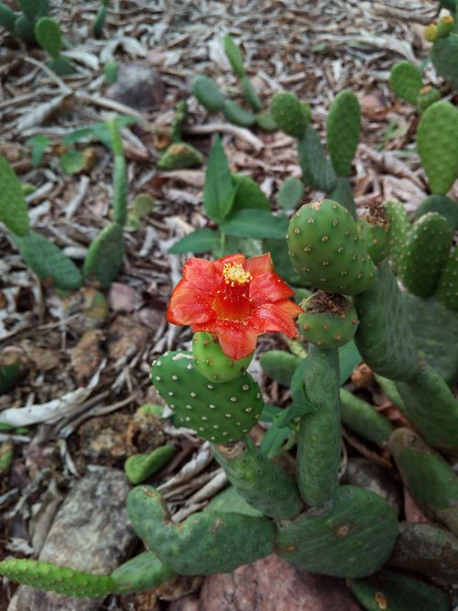
Tacinga inamoena
Uses:
  Fodder only (burnt or cut)

Slide 11
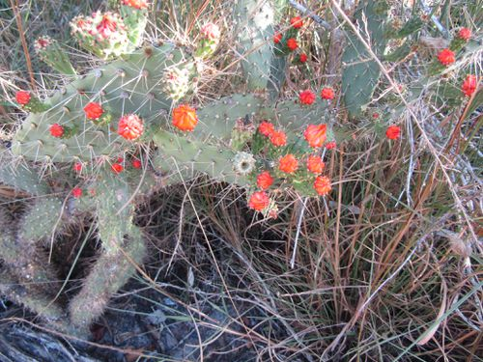
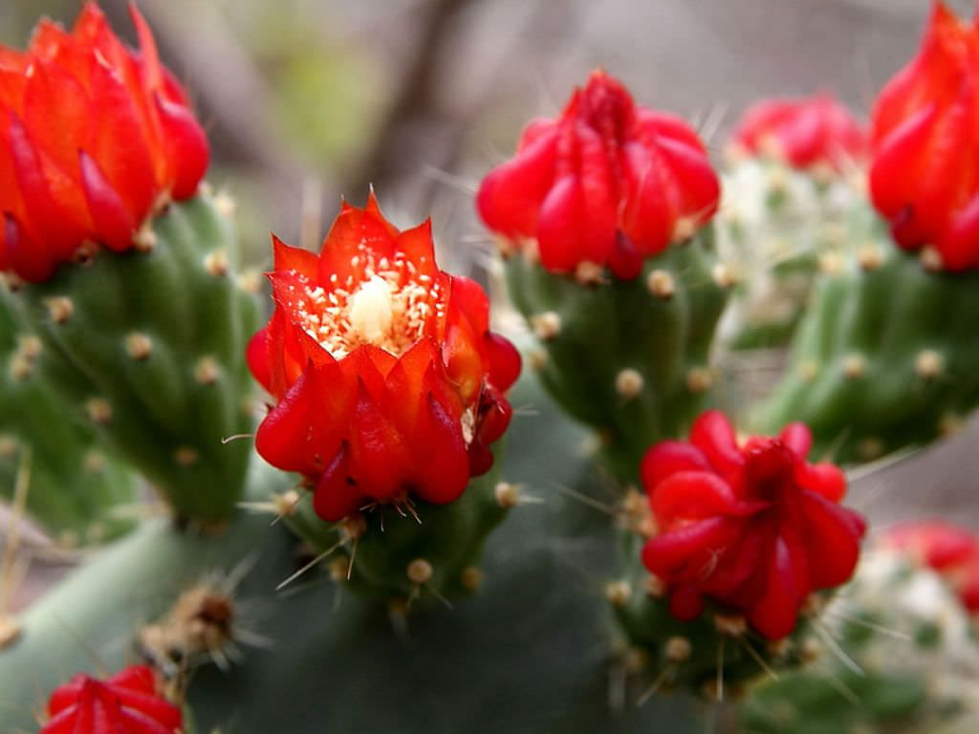
Tacinga palmadora
Uses:
  Human food
  Ornamental
  Fodder

Slide 12
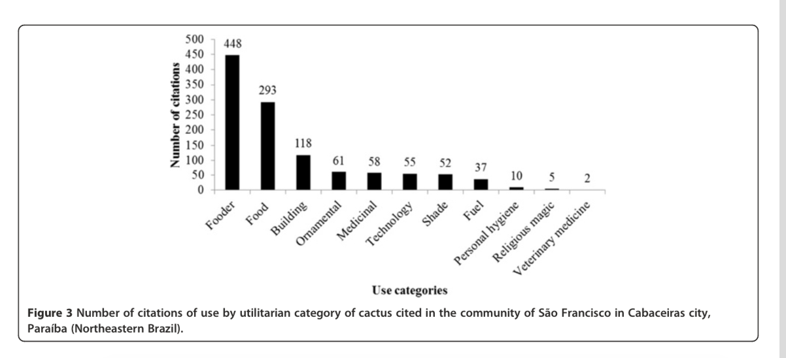
Conclusions
Main uses of cactaceae:
  Forage
  Food
  Construction
Most commonly used plant:
  P. Pachyladus!

Slide 13
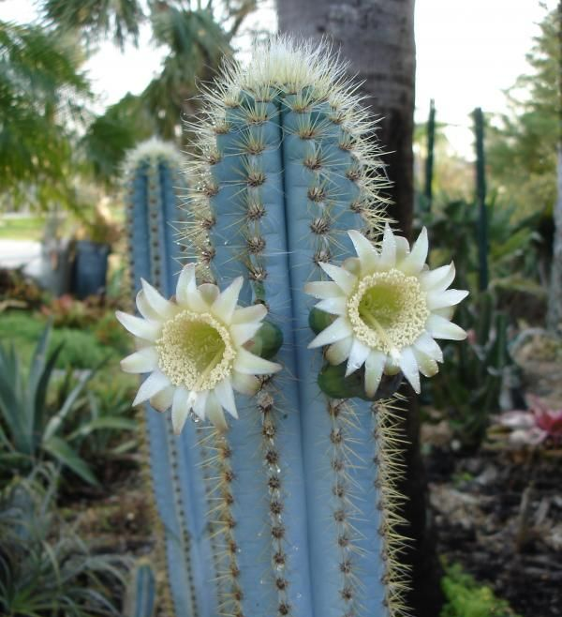
Questions?
Favorite plant of the set?
Potential other uses?
Importance of ethnobotany and conservation

